Slide 1

European Breakdown DNA Project Plan
Summer Kenney

Slide 2



Executive Summary
Ancestry.com has gathered and analyzed DNA from millions of customers across the globe. They have developed algorithms assessing geographical locations based on DNA samples cross tested with ancient sample excavation and other Ancestry members.
An area of difficulty lies with the abundance of DNA samples from the region of Northwestern Europe and the similarity in DNA types, which makes pinpointing an exact geographical point of origin difficult.
This project will gather DNA data from all users that indicate a connection to the Northwestern European Region and compare it with data gathered from completed family trees. In so doing we will be able to compare details in the DNA with confirmed ancestry from specific regions. This will allow Ancestry to be more specific in their classification of origin. An example would be, the ability to pinpoint a customer's background to Belgium instead of the more generic Northwestern Europe.

Slide 3




Executive Summary Cont.
By examining the two components of data available. – the raw DNA collected and the family trees that the customers have created, we can find and test correlations that will allow us to accurately pinpoint more exact geographical locations allowing customers to have a heightened experience.

Slide 4

Business Objectives
Be able to identify Northwestern European (NE) DNA by the following specific regions:
The Netherlands
Belgium
Luxembourg
Northern Switzerland
Northern France
South Scotland
Eastern Wales
England (North or South)
The cross-examination of the DNA data with the data from the personal family trees will allow us to create a comprehensive algorithm to assign a sub geographic location with a range of accuracy between 70-85%.
All (NE) DNA will be able to be identified by greatest likelihood into one of the above-mentioned subcategories.
By doing this we will be providing users with a more personalized and unique experience. Giving them a richer understanding of their heritage.
5, Currently no other DNA website offers such a specific breakdown of European heritage making Ancestry stand apart from the competition.

Slide 5
Background and Scope
Background
Ancestry.com now has over 20 million people in their DNA database making them the largest autosomal DNA database by nearly 10 million (theDNAGeek, para.3, 2022). They currently test ethnicity against over 1,700 different regions that include: Africa, Asia, Europe, America, Oceania and West Asia.
Scope
This project will run with the following scope in mind.
DNA must have 40% EU DNA to be included in the study.
Only family trees from members with 40% EU DNA will be studied.
New data is being added daily. There will be a cut -off date of July 1st 2022 whereby no more new data will be added to the set or considered in the study.
No new regions other than what was listed in the business objectives will be considered for this project.
Family Tree study will only include direct ancestors.

Slide 6
Functional Requirements
The project will work in the following phases:
Gather DNA raw data and Family Tree Raw data
2. Two teams will work together simultaneously on cleaning and wrangling the data using SQL and Jupyter Studio in either R or Python language.

Slide 7
Family Tree Data
The family tree data will be mined for ‘country of birth’ and every country of birth that falls within the previously mentioned scope of EU will be given a numeric value that corresponds to that Country as follows:
The Netherlands (1)
Belgium (2)
Luxembourg (3)
Northern Switzerland (4)
Northern France (5)
South Scotland (6)
Eastern Wales (7)
England (North) (8)
England (South) (9)
Each customer name will then have a number(s) assigned to them that represents all of the ancestors in their tree with EU heritage. Example: Ellen Williams has a great grandfather and grandmother from Belgium, a mother from Cornwall and 4 direct descendants from France. Her information would look like this:
Ellen Williams - 2,2, 9, 5,5,5,5.

Slide 8
Raw DNA data
The customer's DNA has already been analyzed and sorted into geographical regions. Our job is to take the DNA sorted EU and look for variances and patterns.
2. The DNA will be grouped according to variances.
Cross-Analysis
Compare the separate variance groups with the individual Tree results. Run tests to see patterns and relationships emerge.
2. For example, Variance A has more ‘2’s than any other variance, leading to a hypothesis that Variance A is linked to DNA from Belgium.
3. Run Hypothesis testing on all potential associations.
4. Gather all results that passed hypothesis testing.
Data Considerations
All team members should familiarize themselves with Ancestry's privacy policies when it comes to handling DNA information.
2. All data is free to use for Ancestry employees as long as they respect the company's policies.

Slide 9




Team
Team A Lead
Team A
Team B Lead
Team B
Programmer
Programmer
Data Scientist
Data Scientist
Data Scientist
Data Scientist
Data Scientist

Slide 10
Team
Personnel Requirements
This project will be conducted in 2 phases and will require 2 separate teams.
Phase 1 - Data Wrangling and Processing
Team A: 2 data scientists adept at data mining and organizing. 2 programmers who are capable of creating useful algorithms. They will be responsible for pulling information from family tree data and finding direct ancestors with EU DNA and classifying them accordingly. Must be able to pay attention to detail and work well at monotonous and exacting tasks
Team B: 3 data scientists who are experts at data manipulation. They will be responsible for combing through the large dataset of raw DNA data to find variations and then create groups based off of those variations. Must have keep problem solving skills and feel comfortable with
advanced statistics.
Phase 2 - Cross Analysis
Team A and B: Here both teams will work together with excellent teamwork and problem-solving skills to apply hypothesis testing to the variant groups and present findings in a clear and meaningful manner.

Slide 11
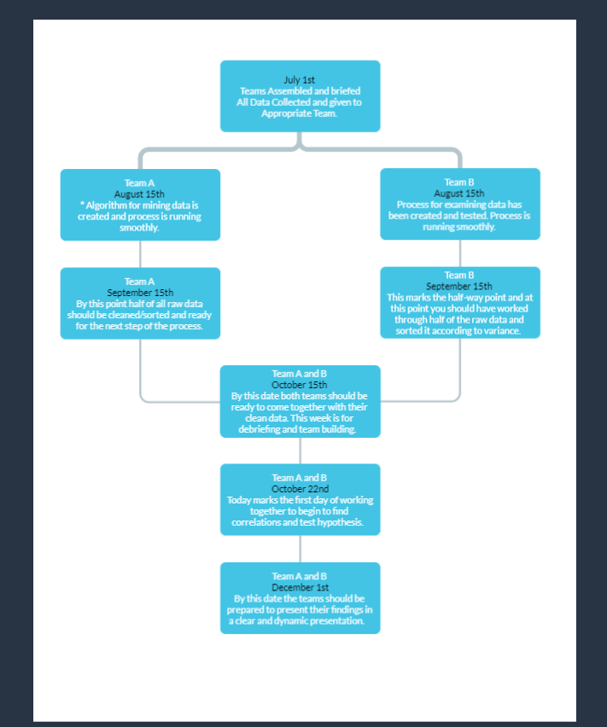
Timeline
Schedule Breakdown:
All schedules allow for weekend time and since teams are employed if an individual is ill this should not affect overall plan (see mitigating risks for more details).
The first week of July is designated to allow for teams to meet, organize and come up with a game plan.
5 weeks are designated for data cleaning, wrangling and algorithm creation before the halfway point. This allows for flexibility, trial and error and the absence of a team member due to illness or holiday time.
After 5 weeks all processes should be running smoothly, and data should be nearing completion and ready for the second stage.
October 15th - 22nd allows for teams to come together, debrief and get to know one another while creating a game plan for the next step.
5 weeks are allotted for the teams to work together to run hypotheses and create a presentation for their findings.

Slide 12
Assumptions/Limitations/Risks & Mitigation
Assumptions
limitations
Risk & mitigation
Assumptions for this project and timeline include the following:
All team members (5 data scientists and 2 programmers) will work full-time during the course of the project.
Access to all data will remain open to all team members.
Communication with management will be timely and consistent.
All team members remain engaged and employed during the course of the program
2. Funding for tools and resources will remain available.
Inclement weather causes shutdown of computers.
Illness (especially related to COVID causes team members to remain at home)
1. Generator will be installed in the office in case of inclement weather operations can resume as planned.
2. Time off for illness or unforeseen circumstances is worked into the schedule, however, should illness last longer than anticipated we have implementations in place to allow employees to work from home.

Slide 13


Thank You
Summer Kenney

